Slide 1









46
LIGHTED
TO
ENLIGHTEN
years

Slide 2


TEAM DETAILS
1
Selected Track - Smart Education
2
Problem Statement Title - Centralised Digital Platform for
Comprehensive Student Activity in HEIs
3
Team Name - DevEon
4
Team Lead - Mir Reza Ali Khan
5
Institute Name - Muffakham Jah College of Engineering and
Technology

Slide 3
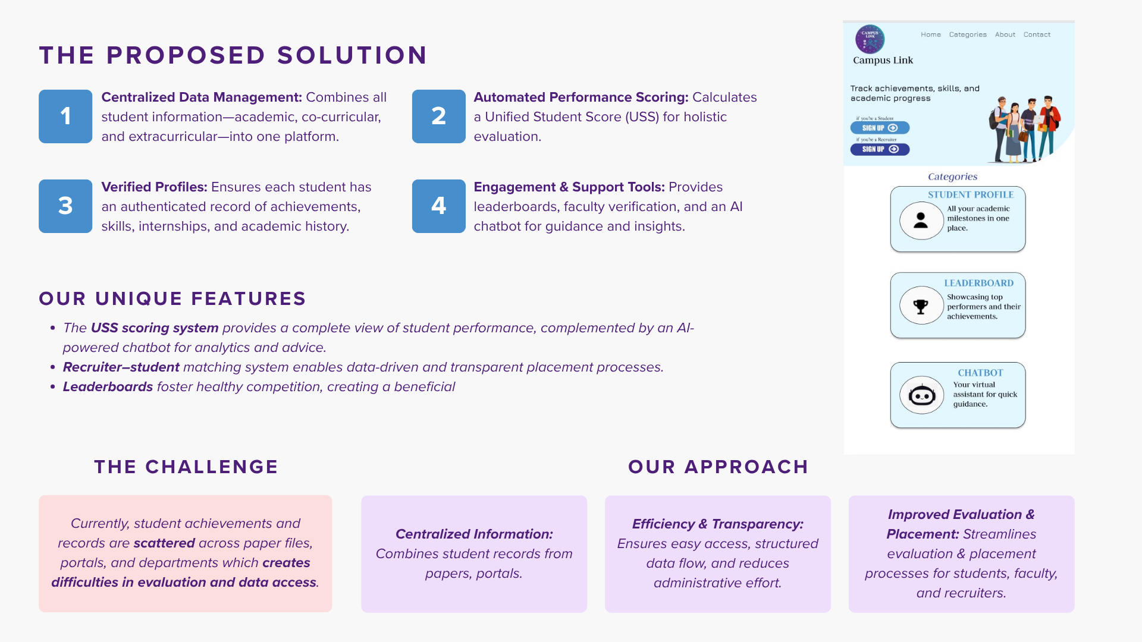
Campus Link

Slide 4
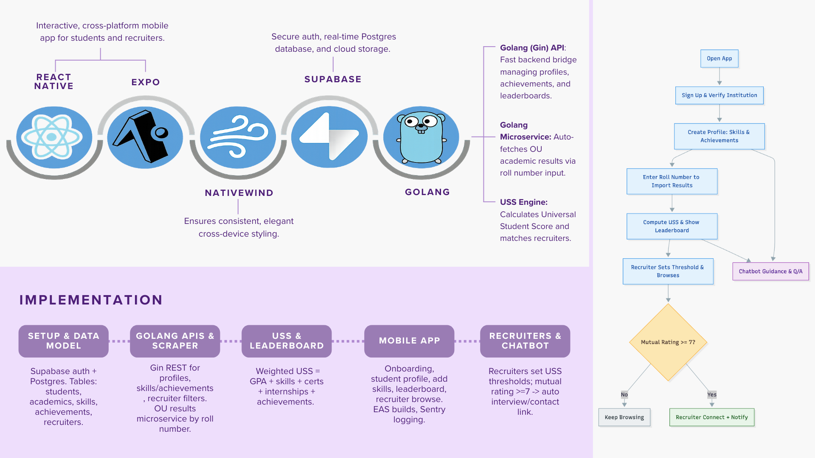
TECHNICAL APPROACH

Slide 5
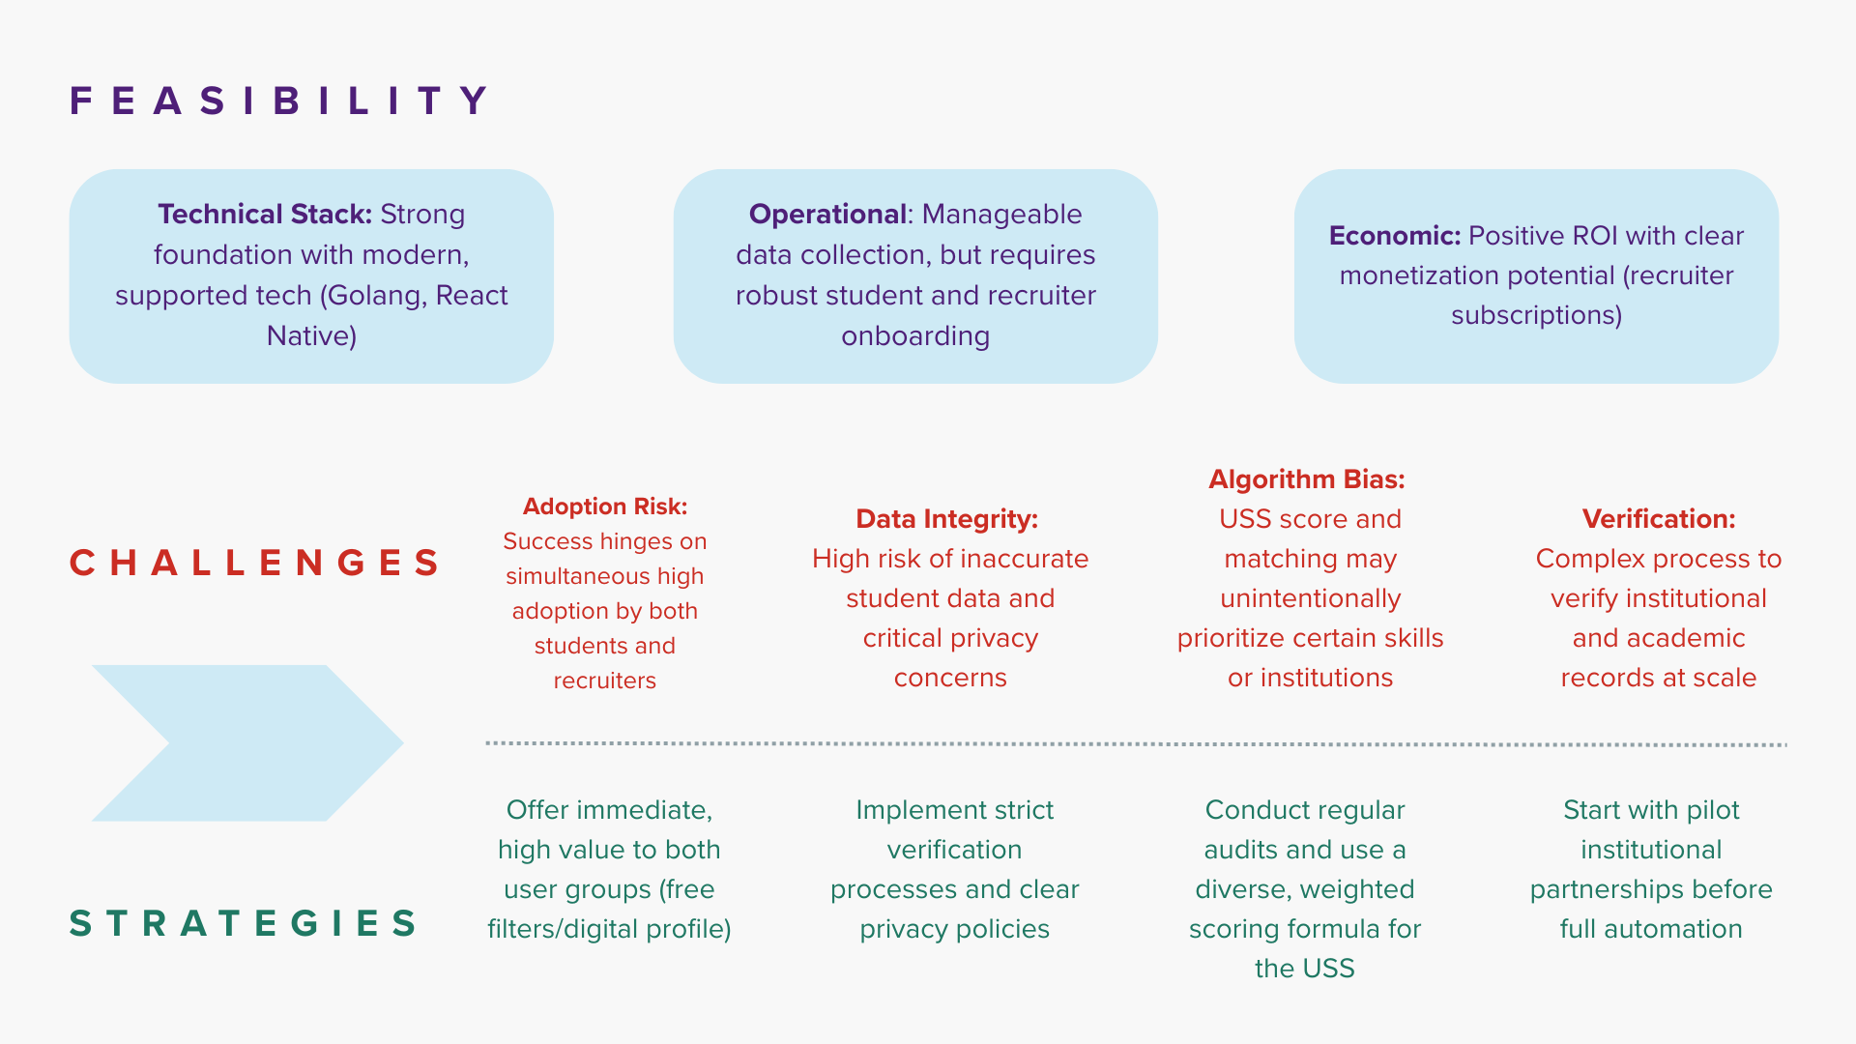
FEASIBILITY AND VIABILITY

Slide 6
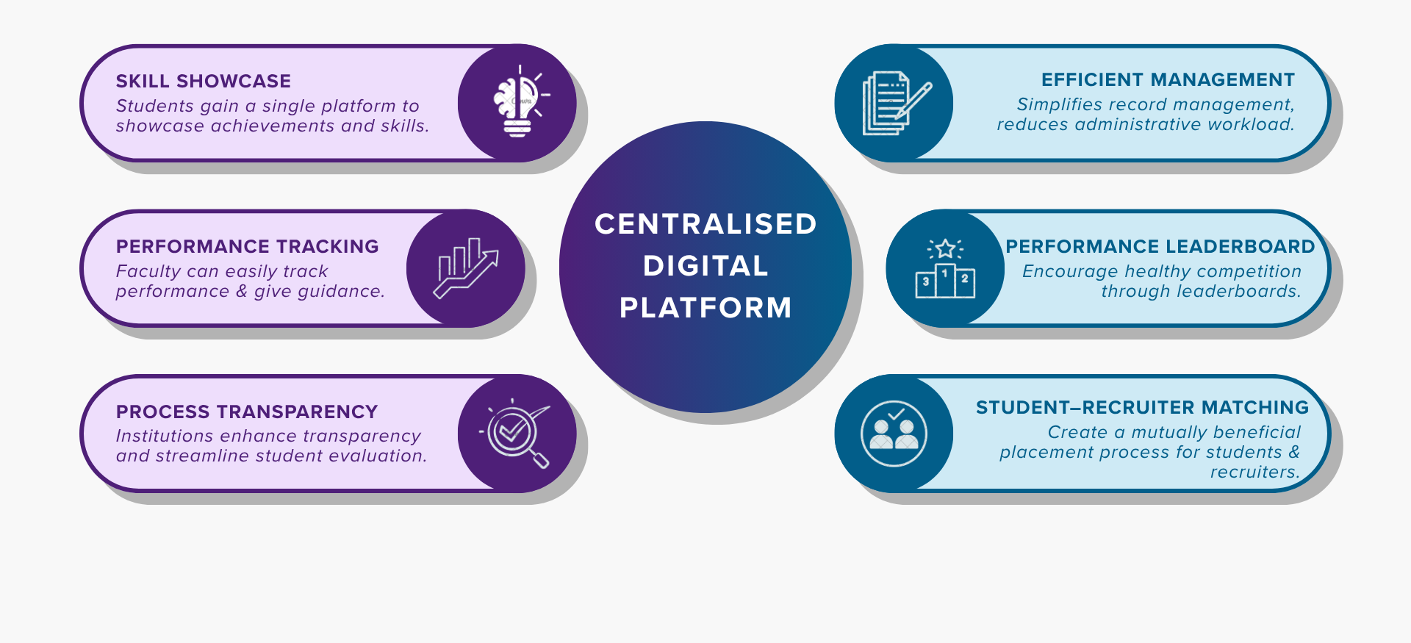
IMPACT AND BENEFITS

Slide 7
Team Member’s Information
Team Leader Name: Mir Reza Ali Khan
Year: 2nd Department: CSE College Name: Muffakham Jah College of Engineering and Technology
Team Member 1 Name: Aaryan Khoja
Year: 2nd Department: CSE College Name: Muffakham Jah College of Engineering and Technology
Team Member 2 Name: Mohammed Saad
Year: 2nd Department: CSE College Name: Muffakham Jah College of Engineering and Technology
Team Member 3 Name: Ahmed Raza
Year: 2nd Department: CSE College Name: Muffakham Jah College of Engineering and Technology
Team Member 4 Name: Mohd Haseeb Uddin
Year: 2nd Department: CSE College Name: Muffakham Jah College of Engineering and Technology
Team Member 5 Name: Saniya Parveen
Year: 2nd Department: CSE College Name: Muffakham Jah College of Engineering and Technology

